Slide 1
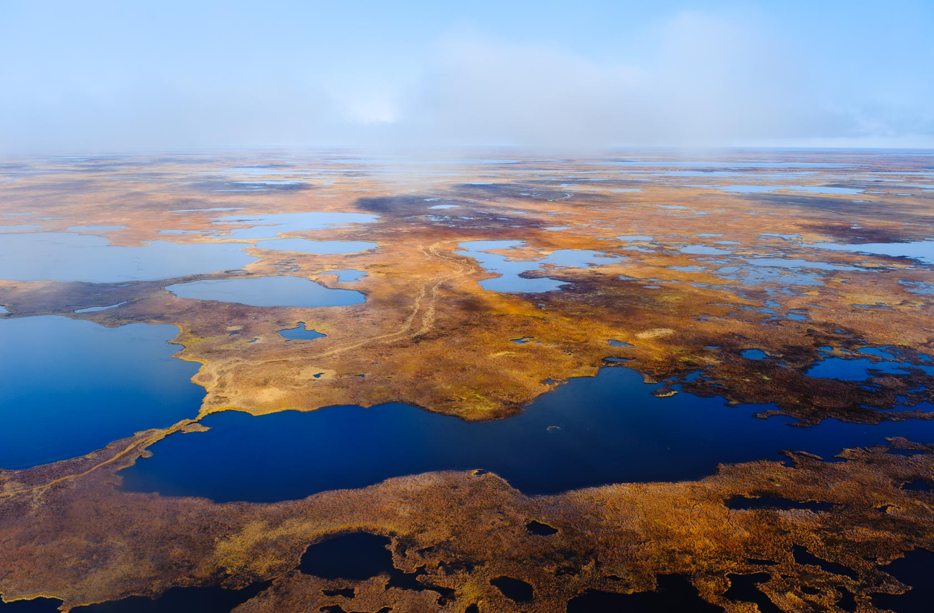
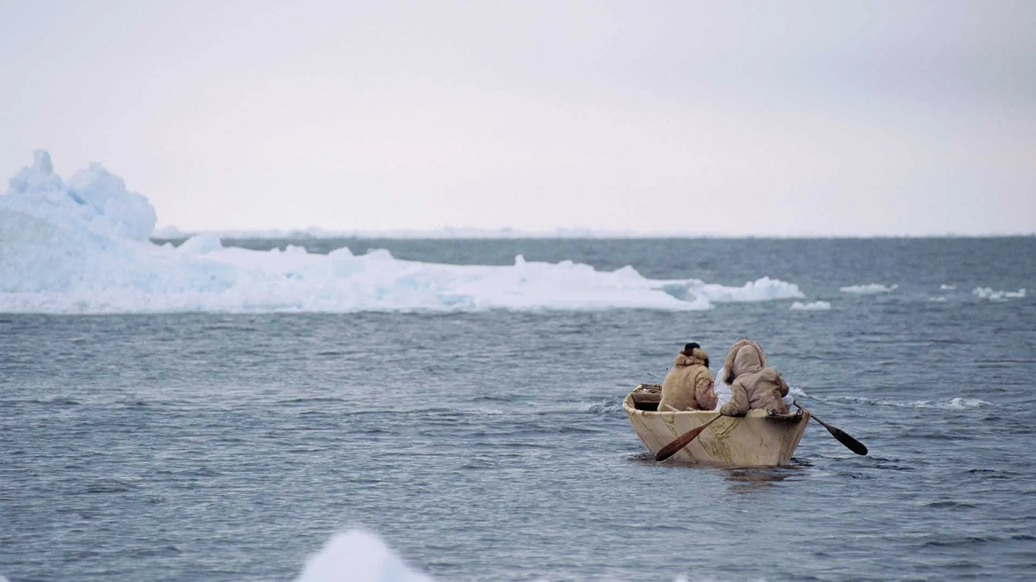
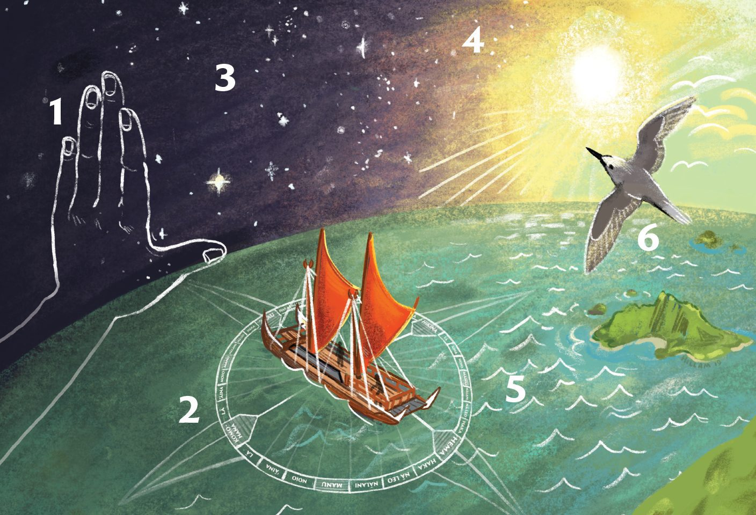
Peopling of the Americas
Bering Land Bridge
Hunters crossed the marshy land bridge from Asia around 13kya during the retreat of the glaciers.
Coastal Route Theory
Migration occurred by boat, people island hopped along the pacific coast of Asia up to Beringia and across (16kya).
Multiple founding populations
People dispersed from Australasia by boat using Polynesian wayfaring techniques.
Alaska Editorial Photography / © Mark Meyer Photography
Galen Rowell / Getty Images
Hannah Hillam / INSTAGRAM
Evidence :
Clovis people were Mammoth hunters thought to have crossed the land bridge after the opening of an ice-free corridor around 13.8kya. Named after the archaeological evidence of their flint spearheads dated to 13kya discovered in Clovis, New Mexico.
Pre-clovis Evidence :
Evidence of human presence in Southern Chile was found too soon after the retreat of ice sheets (14kya) that were blocking access into Eastern Beringia (modern Canada) from Asia which meant an earlier dispersal.
DNA from skeletons in Colombia dated to 8kya suggests via Bayesian Coalescent Analysis that a small population originally isolated in eastern Beringia entered Americas around 16kya (before overland was possible).
Evidence :
It was found that some modern Amazonian Native Americans were descended from a founding population with more genetic similarity to indigenous Australians than North or Mesoamericans.
This would indicate that South America was established by several distinct founding populations some journeying from the other side of the pacific.
Stone, R. (2021). A Land Bridge to Nowhere? Science.org. [online] doi:https://doi.org/10.1126/article.35167.
Llamas, B. et al. (2016) ‘Ancient mitochondrial DNA provides high-resolution time scale of the peopling of the Americas’, Science Advances, 2(4). doi:10.1126/sciadv.1501385.
Skoglund, P. et al. (2015) ‘Genetic evidence for two founding populations of the Americas’, Nature, 525(7567), pp. 104–108. doi:10.1038/nature14895.

